Slide 1
Creating the Perfect Linux
Desktop

Slide 2
Understanding Linux Desktop Technology
Modern computer desktop systems offer graphical windows, icons, and menus that are operated from a mouse and keyboard.
Nearly every major Linux distribution that offers desktop interfaces is based on the X Window System (http://www.x.org).

Slide 3
The X Window System provides a framework on which different types of desktop environments or simple window managers can be built.
X works in a sort of backward client/server model.
  The X server runs on the local system, providing an interface to your screen, mouse, and keyboard.
  X clients (such as word processors, music players, or image viewers) can be launched from the local system or from any system on your network, provided that the X server gives permission to do so.

Slide 4
different desktop environments
  GNOME
  K Desktop Environment
  Xfce
  LXDE

Slide 5
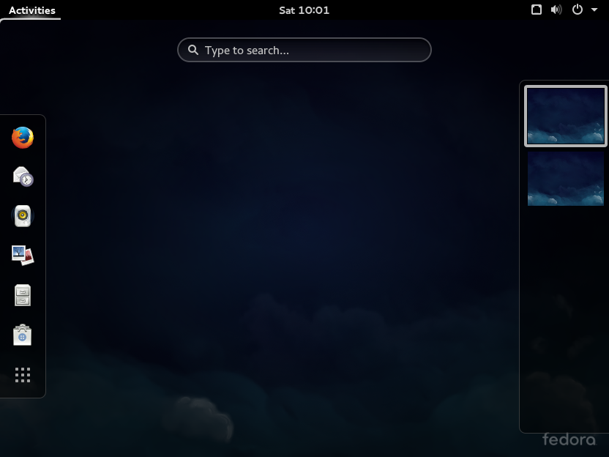
GNOME 3 desktop in Fedora

Slide 6
X客户端（应用程序）
X客户端（应用程序）
X工具包、Gtk+,Qt
X工具包、Gtk+,Qt
XLib
XLib
网络协议
X服务器
设备驱动程序

